Slide 1




CALL DEFLECTION OPTIMIZATION USING DATA INSIGHTS
Name: Anu Anand
Program: Business Analytics | Oakland University
Notes:
Hi everyone, I’m Anu Anand, and today I’ll be presenting my capstone project: Call Deflection Optimization Using Data Insights. This project explores how ACG can use predictive analytics to reduce unnecessary live calls and improve overall efficiency.

Slide 2
ABSTRACT
This project focuses on reducing live customer calls at ACG by analyzing service request data.
Two business problems were addressed: identifying why cancellations happen and predicting contact center assignment.
Machine learning models (Random Forest and Logistic Regression) were used to predict outcomes and explain influential patterns.
Tools: Python, SMOTE, statsmodels, Power BI.
Notes:
We tackled two business problems:
Can we predict how a service request will end—successfully, canceled, at-risk, or flagged for review—early enough to act on it?
Can we predict which contact center should handle a request right at the beginning?
We used Random Forest, Logistic Regression, and Power BI to build models and dashboards that support real-time decision-making

Slide 3


PROBLEM STATEMENT
ACG handles many service requests daily. A large number of these result in live calls.
Live calls are helpful but expensive and time-consuming.
Objectives:
Predict the outcome of a service request: successful, canceled, at-risk, or needing follow-up
Predict which contact center (ERS Online, AAA App, Smart Action) will handle the request
Notes:
ACG handles thousands of service requests every day, and many of these still come through live calls. While necessary in some cases, live calls are expensive, slow, and often avoidable.
So we asked:
Can we predict the likely outcome of a request before dispatch?
Can we tell in advance which contact center should take the job—ERS Online, AAA App, or Smart Action?

Slide 4

ORGANIZATIONAL CONTEXT
The Auto Club Group (ACG) is a prominent member-based organization that provides a wide range of services, including roadside assistance, insurance, travel planning, and financial products across several regions in the United States
Customers use phone, app, or web to request help, but many still rely on phone calls.
Goal: Understand when and why live calls happen, and optimize routing to save cost and improve efficiency
Notes:
ACG serves members with services like roadside assistance, insurance, and travel. Customers reach out via phone, app, or web—but many still prefer live phone calls.
Reducing live calls could improve speed, reduce costs, and better match customers to the right support channels.

Slide 5
SYSTEM CAPABILITIES & BUSINESS BENEFITS
System Capabilities:
Predict cancellations and issues before they happen
Assign requests to the right contact center
Visualize patterns using Power BI dashboards
Benefits:
Reduce live calls and improve self-service usage
Allocate agents and providers better
Improve customer satisfaction and reduce delays
Notes:
Our system does three things:
Predicts cancellations and risk-prone requests
Assigns requests to the correct contact center
Visualizes trends using interactive dashboards
The benefits include reduced call volume, better agent utilization, and fewer delays.

Slide 6
DATASET OVERVIEW & PREPARATION
Two datasets were used in this analysis:
The first dataset (5GB) was filtered to 179,539 records and 13 selected columns. This dataset was used for Objective 1.
The second dataset was a merged version, created by joining the 5GB and 37GB datasets.
These datasets were joined using SVC_REQ_ID and SVC_REQ_DT.
The merging was based on overlapping records from January 1 to August 16, 2020.
The result of this join was a merged dataset with 5,000 records and 18 columns. This merged dataset was used for Objective 2.
Notes:
We used two datasets:
A filtered set of 179,539 records for Objective 1: predicting service outcomes
A merged dataset of 5,000 records for Objective 2: predicting contact center routing
Both were cleaned, joined by service ID and request date, and balanced using SMOTE to prepare for modeling.

Slide 7
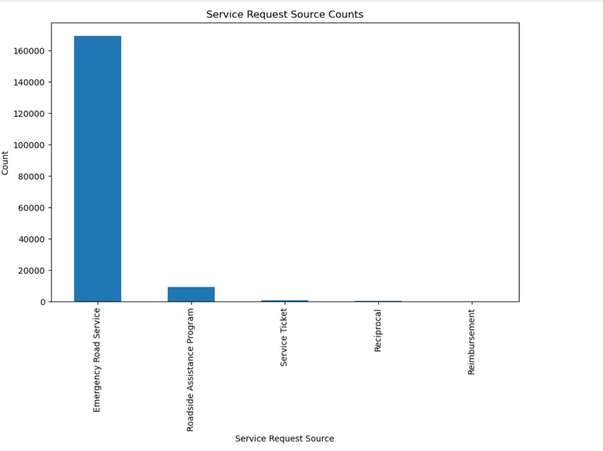
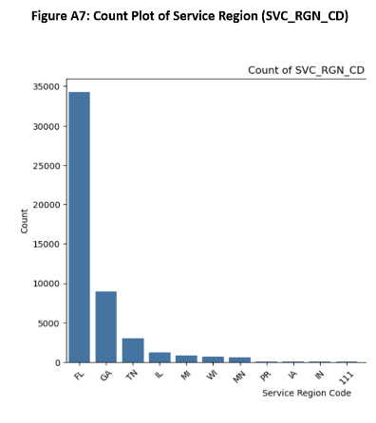
EXPLORATORY DATA ANALYSIS (EDA)
90% of requests came through Emergency Road Service
Florida had the highest volume (around 60%)
Notes:
Some quick takeaways from our data:
Over 90% of requests came through Emergency Road Service
Florida had the highest volume

Slide 8
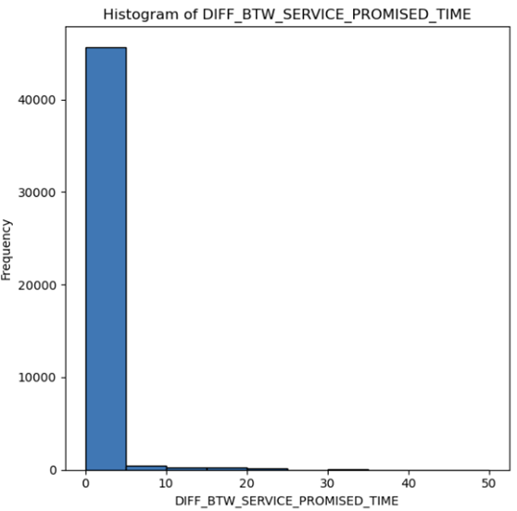
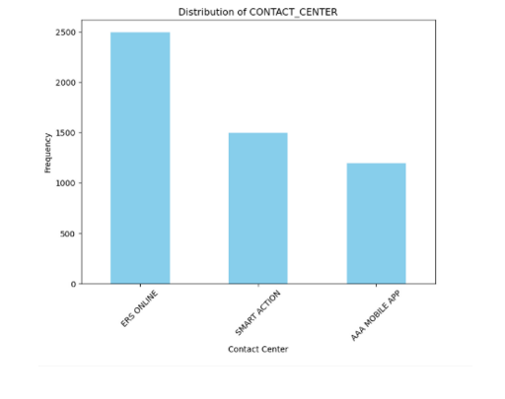
EXPLORATORY DATA ANALYSIS (EDA)
Most delays were near zero, but a few had long delays
Most common request for Contact center :ERS online
Notes:
Most delays were minimal, but a few extreme cases drove up costs
ERS Online handled most of the requests

Slide 9
FEATURE ENGINEERING & MODELING APPROACH
Encoded categorical variables (like request source and service region)
Balanced classes using SMOTE for better model training
Models Used:
Random Forest: Great for accuracy and handling complex patterns
Logistic Regression: Good for understanding the effect of each input
Notes:
We encoded categorical variables and balanced the dataset using SMOTE. Then we trained two models:
Random Forest, great for messy, imbalanced data
Logistic Regression, helpful for understanding how each variable affects the outcome

Slide 10
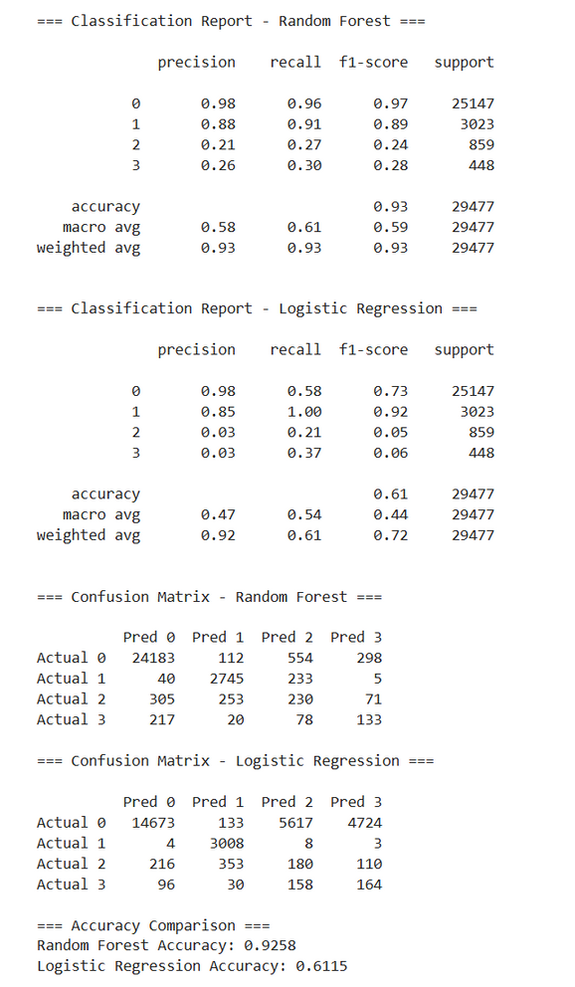
OBJECTIVE 1 – CANCELLATION CLASSIFICATION
Predicting Service Request Outcomes -
The objective is to classify LST_STAT_RSN_TXT (Last Status Reason Text) into four outcome categories to flag cancellations and risk-prone cases early.
Class 0 – Successful: Includes completed or internally closed cases (e.g., SERVICE COMPLETED, CASH CALL).
Class 1 – Canceled: Explicit cancellations (e.g., CANCEL).
Class 2 – At-Risk: Failed attempts likely to result in cancellation (e.g., Unsuccessful Service Attempt, GONE ON ARRIVAL).
Class 3 – Potential Impact: Under internal review or flagged for follow-up (e.g., Member Appeasement, Facility Accountable).
Model Insights:
Random Forest achieved 92.6% accuracy, effectively handling complexity and class imbalance.
Logistic Regression showed 61.1% accuracy, underperforming due to overlapping patterns and data imbalance.
Notes:
Script: For Objective 1, we predicted the variable LST_STAT_RSN_TXT, which describes how a service request ended.
We classified it into 4 groups:
Class 0 – Successful
Class 1 – Canceled
Class 2 – At-Risk (e.g., GONE ON ARRIVAL)
Class 3 – Potential Impact (e.g., Needs Audit)
Random Forest achieved 92.6% accuracy, successfully flagging risky requests early. Logistic Regression performed lower at 61.1% but gave helpful insights on driver importance.

Slide 11
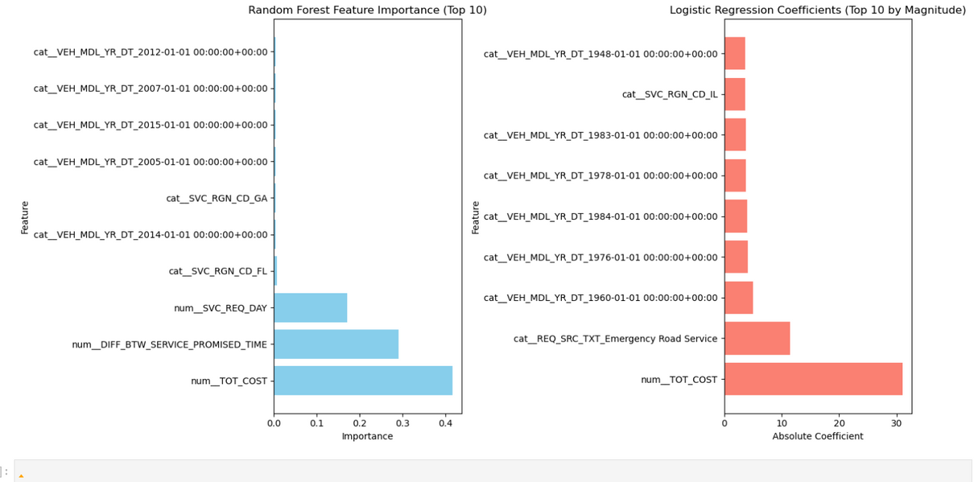
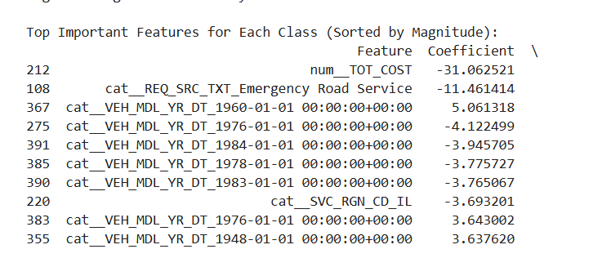
OBJECTIVE 1 – CANCELLATION CLASSIFICATION
Important Coefficients (Logistic Regression):
TOT_COST = -31.06: As cost increases, cancellations decrease (negative impact on being Class 1)
REQ_SRC_TXT_Emergency Road Service = -11.46: ERS requests are less likely to be canceled
VEH_MDL_YR_DT_1960 = +5.06: Very old cars increase the chance of being flagged for internal follow-up (Class 3)
VEH_MDL_YR_DT_1976 = -4.12, 1984 = -3.95: Lower chance of being marked at-risk or impact
Important Features (Random Forest):
TOT_COST: Most important driver across all classes
DIFF_BTW_SERVICE_PROMISED_TIME: Delays strongly influence cancellation or risk
SVC_REQ_DAY: Service request day shows moderate impact
Vehicle year & region features had very low importance in RF model
Notes:
From Logistic Regression, we saw:
Higher total cost meant less chance of cancellation
Requests from ERS were more likely to succeed
Very old vehicles like 1960 were more likely to be flagged internally
Some years, like 1976 and 1984, were less risky
From Random Forest, top drivers included:
TOT_COST
Service delays
Day of request
Together, these models let us predict problems before dispatch, creating room for ACG to act proactively.

Slide 12
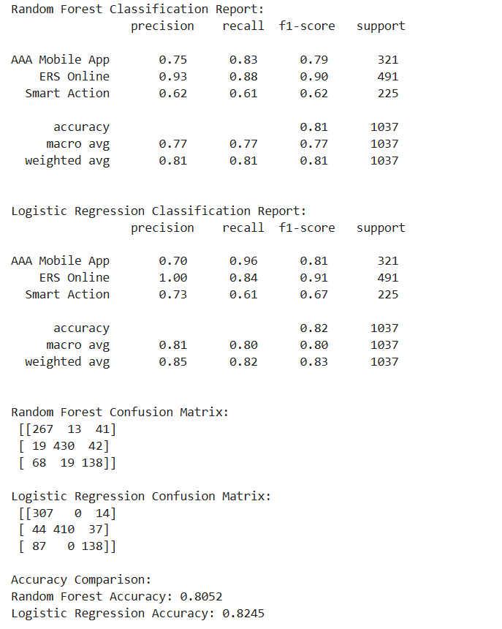
CONTACT CENTER ASSIGNMENT
Predict which of the 3 contact centers will be assigned to handle each service request based on issue type, delays, provider, region, and request source.
Contact Center Class Labels:
Class 0 → AAA Mobile App
Class 1 → ERS Online
Class 2 → Smart Action
Model Results:
Logistic Regression: 82.5% accuracy
Slightly better overall performance across all classes
Random Forest: 80.5% accuracy
Performs well with complex feature interactions and non-linear patterns
Notes:
Script: For Objective 2, we predicted which contact center would handle a given request:
Class 0 → AAA App
Class 1 → ERS Online
Class 2 → Smart Action
Logistic Regression reached 82.5% accuracy, and Random Forest hit 80.5%. Both models revealed clear patterns in how requests were routed.

Slide 13
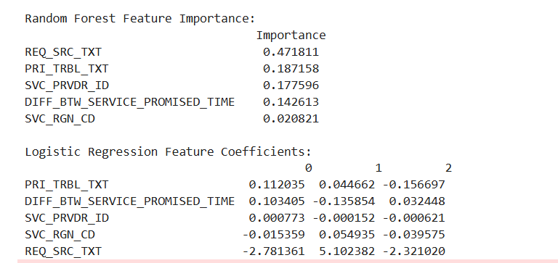
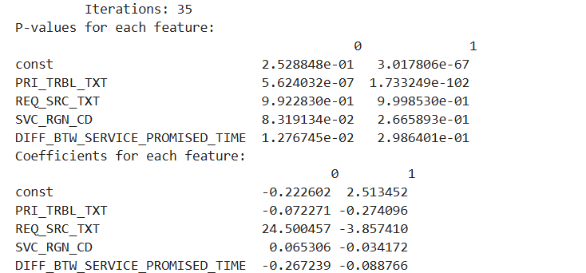
CONTACT CENTER ASSIGNMENT
Feature Insights – Model Comparison
Random Forest:
Top Drivers:
REQ_SRC_TXT (0.47) – Most important
PRI_TRBL_TXT (0.19) – Key predictor
SVC_PRVDR_ID (0.18), Delays (0.14) – Moderate impact
Region (0.02) – Minimal effect
Insight: Request source and trouble type drive predictions; captures non-linear patterns missed by logistic regression.
Logistic Regression (Class 1 – ERS Online):
PRI_TRBL_TXT (+0.045) – Statistically significant
REQ_SRC_TXT (+5.10) – Large weight, but not significant
Delays (-0.136) – Slight negative impact, not significant
Region (+0.055) – Small, but significant
Provider – Very low influence
Summary: Random Forest outperforms by capturing complex patterns; logistic regression struggles with signal overlap and class imbalance.
Notes:
Script: From Random Forest, the top predictors were:
Request Source (very strong)
Trouble Type
Service Provider and Delays
Region had minimal impact
From Logistic Regression:
Trouble Type was statistically significant
Request Source had a large effect, but overlapping signals made it less precise
Delays and Region had minor influence
The models confirmed that we can predict routing early—before the request is even answered live.

Slide 14
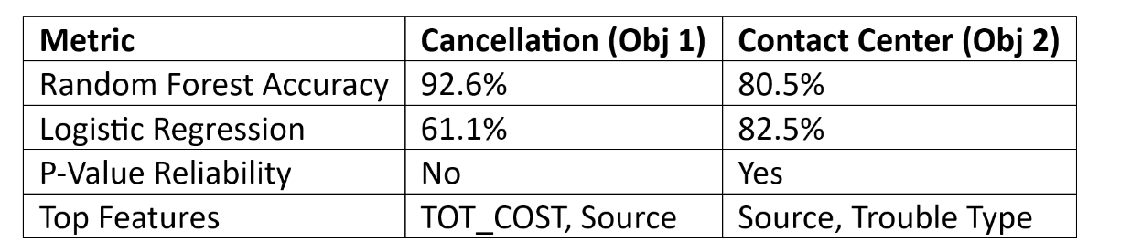
MODEL COMPARISON – OBJECTIVE 1 VS OBJECTIVE 2
Use Random Forest when patterns are messy or classes are uneven
Use Logistic Regression when features are clear and balanced
Notes:
Use Random Forest when data is messy or unbalanced—like cancellations
Use Logistic Regression when data is clean—like routing
Each model serves a purpose, and together they provide both accuracy and interpretability.

Slide 15
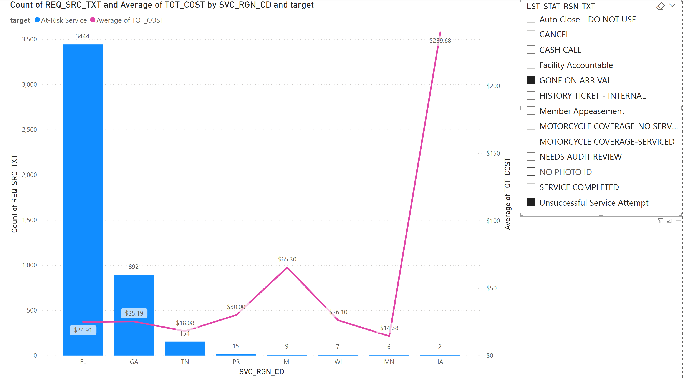
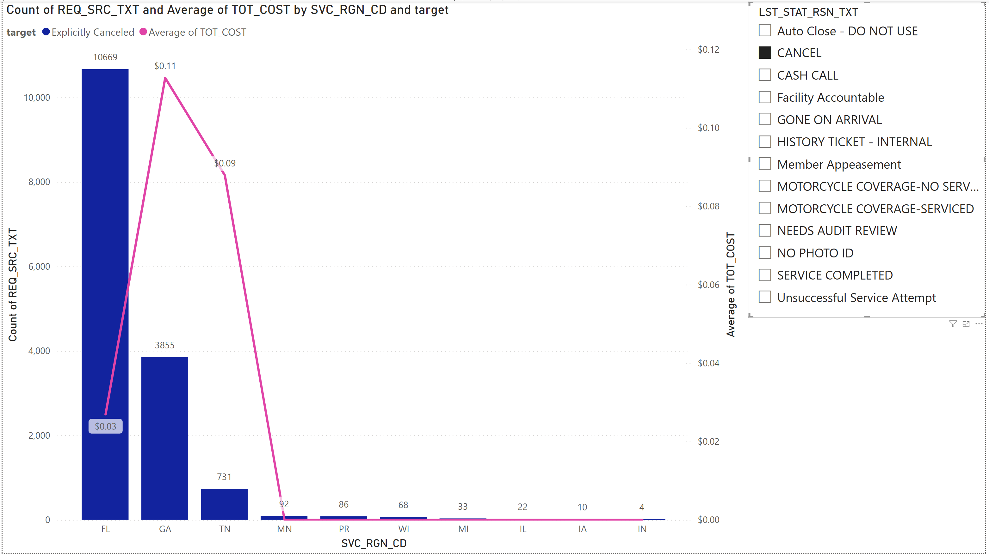
POWER BI DASHBOARDS – OBJECTIVE 1 INSIGHTS - HELPED VISUALIZE THE TYPES OF SERVICE OUTCOMES AND THE ASSOCIATED COSTS ACROSS REGIONS
CLASS 1 (CANCELED)
CLASS 2 (AT-RISK)
Class 1 (Canceled): Florida and Georgia saw the most cancellations, but at a low average cost ($0.11), indicating early-stage cancellations before dispatch.
Class 2 (At-Risk): Iowa had few at-risk cases, yet a high average cost ($239.68), highlighting how even low volumes of failed services can drive up expenses.
Notes:
These dashboards validated what our models predicted:
Class 1 (Canceled): Florida and Georgia had many cancellations, but they were low cost—these are early-stage and perfect for self-service
Class 2 (At-Risk): Iowa had few at-risk cases but very high average costs—showing why early prediction is critical
👉 These are cases where the provider was dispatched but never delivered service. If we can catch these early, ACG can send a pre-dispatch confirmation message to the member:
“We’re about to send help. Do you still need assistance?” If the answer is “no,” we cancel the trip—saving time, fuel, and money

Slide 16
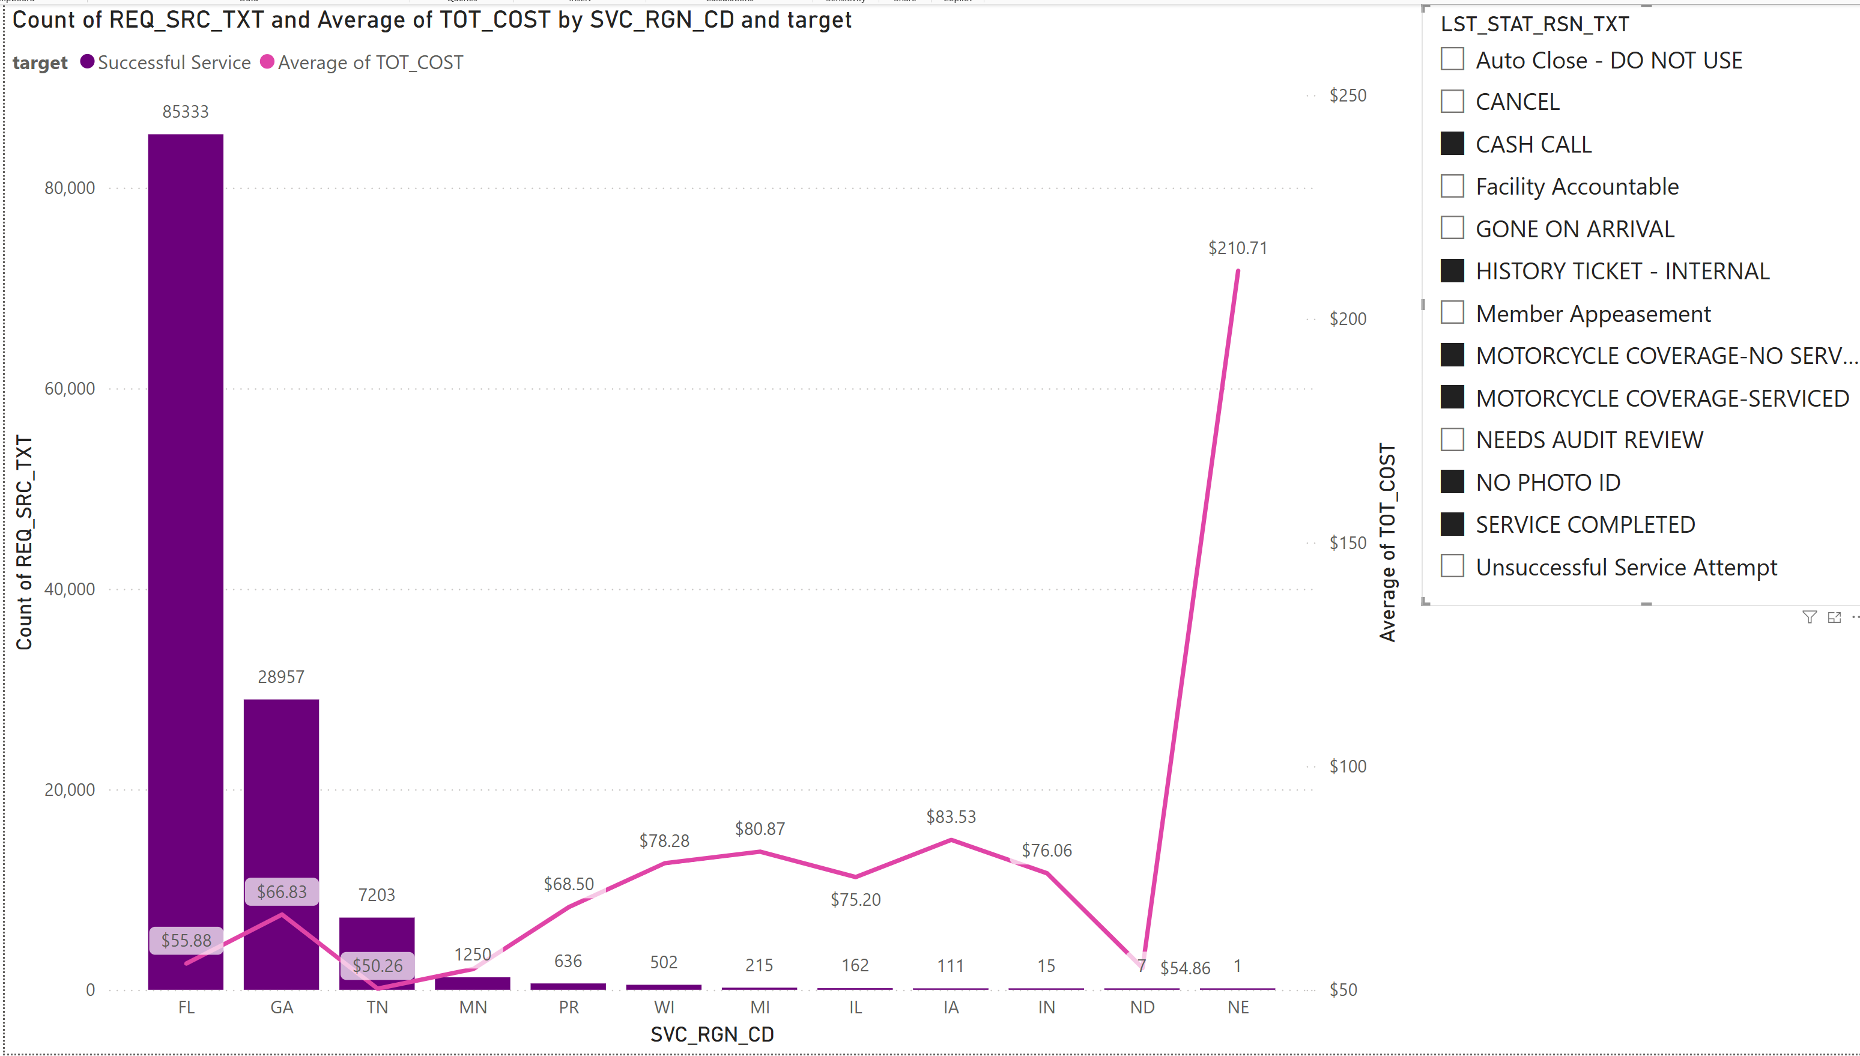
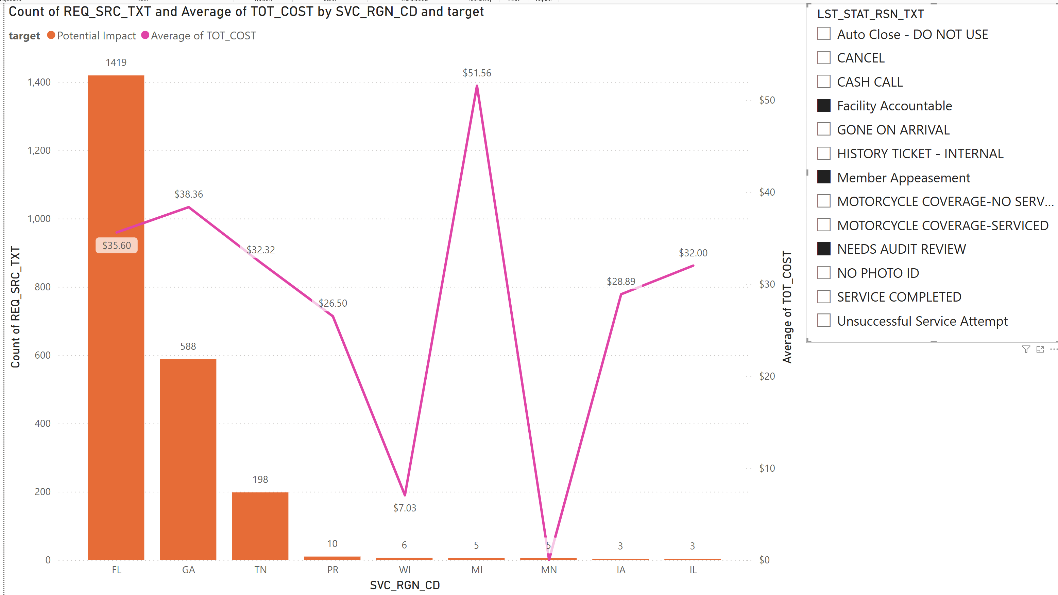
POWER BI DASHBOARDS – OBJECTIVE 1 INSIGHTS
CLASS 3 (POTENTIAL IMPACT)
CLASS 0 (SUCCESSFUL)
Class 3 (Potential Impact): Rare but expensive; Michigan had the highest average cost ($51.56) per case.
Class 0 (Successful): Florida led with over 85,000 successful services at an efficient average cost of $35.60.
Summary Insight: The model effectively flagged both low-effort and high-risk requests, helping teams focus interventions early and control operational costs.
Notes:
Class 3 (Potential Impact): Michigan had rare but expensive escalations
Class 0 (Successful): Florida again stood out for high volume and low cost—an operational benchmark

Slide 17
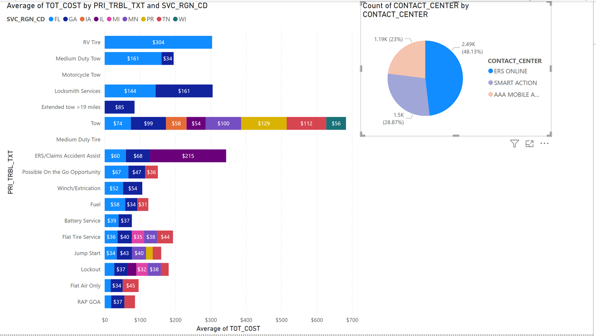
POWER BI DASHBOARDS – OBJECTIVE 2 INSIGHTS
ERS Online: Handled complex services but also received many low-effort cases (e.g., Lockouts ~$37), which could be automated.
Notes:
Script: We also visualized contact center performance:
ERS Online handled many simple services like lockouts and jump starts
These are better suited for automated channels like the AAA App or Smart Action
AAA App performed well for flat tires and jump starts
Smart Action handled fuel deliveries reliably
Michigan showed high service costs for simple issues—hinting at misrouting
👉 This shows ERS Online is overloaded, taking jobs that could easily be automated, increasing cost and wait time.

Slide 18
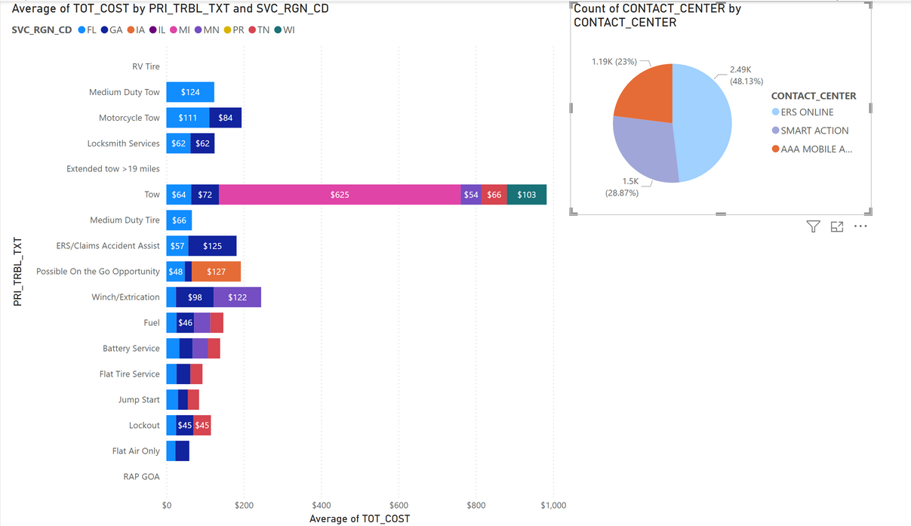
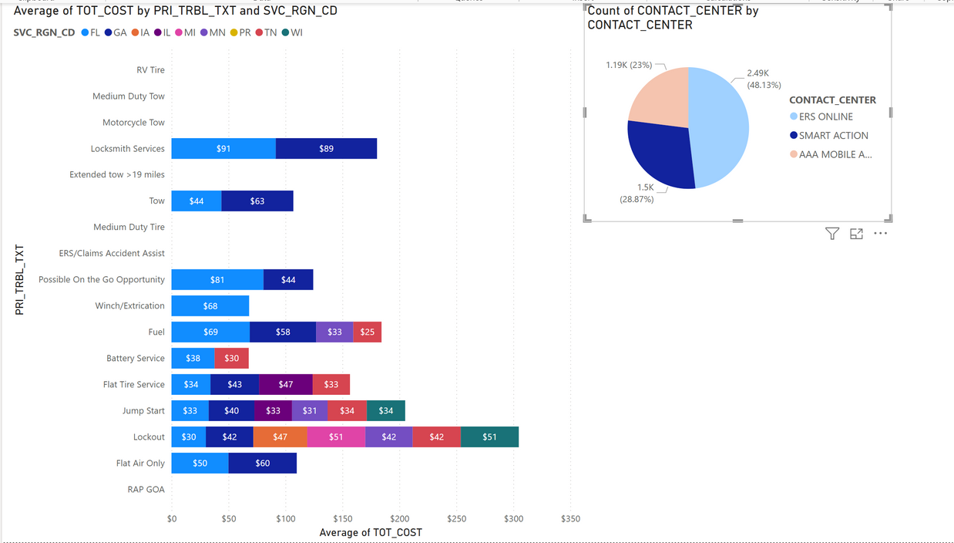
POWER BI DASHBOARDS – OBJECTIVE 2 INSIGHTS
AAA Mobile App: Efficiently managed simple, low-cost services like Flat Tire and Jump Start (~$28–$31).
Smart Action: Consistently handled predictable services like Fuel Delivery and Flat Air.
Regional Issues: High costs in regions like Michigan (e.g., $625 for a tow) signal misrouted requests.
Summary Insight: Aligning automation-friendly requests with the right channels can reduce costs, ease agent load, and improve service speed.

Slide 19


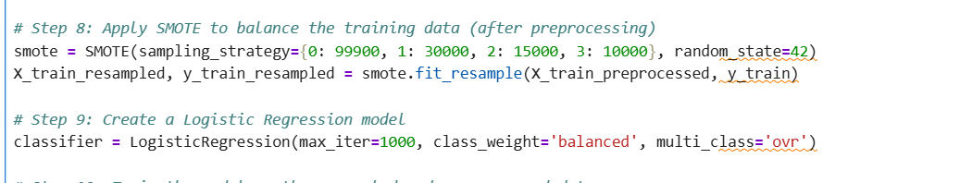
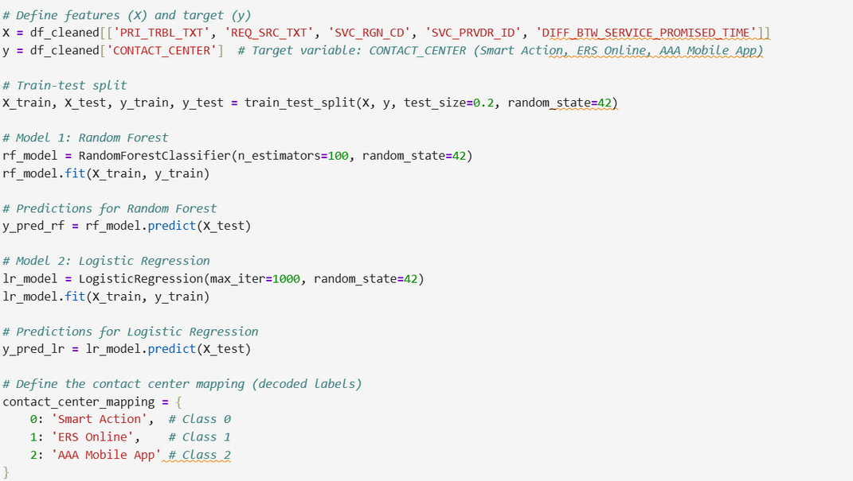
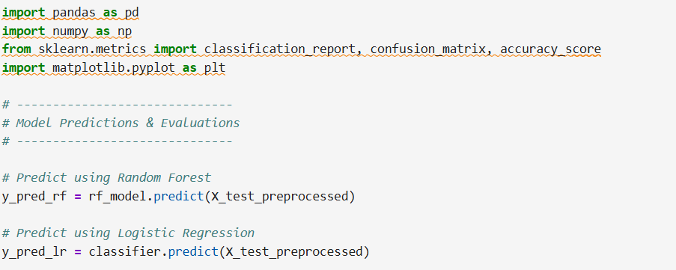
MODEL BUILDING CODE SNIPPETS
OBJECTIVE 1
OBJECTIVE 2

Slide 20
RECOMMENDATIONS BASED ON MODEL FINDINGS
The model results and dashboards tell a clear story about where ACG can act more proactively to improve service outcomes and reduce costs.
For Cancellation Prediction (Objective 1):
Some requests, especially in regions like Iowa and Wisconsin, were small in number but extremely costly when they failed. These were often Class 2 (At-Risk) or Class 3 (Potential Impact).
Early detection of these high-cost outliers can help ACG intervene before a service fails. For example, a pre-dispatch check or automated message could confirm if the member still needs help.
Cancellations were common but low-cost in places like Florida and Georgia, which suggests cancellations happened early in the process—these might be reduced through better self-service options.
Older vehicles (like model year 1960) were more likely to lead to complications and should trigger internal flags.
Notes:
Here’s what ACG can do next:
Use the models to trigger real-time alerts or digital options
Send pre-dispatch confirmations for at-risk requests
Redirect simple tasks away from ERS Online
Adjust routing rules based on cost patterns by region
Retrain models regularly to keep them relevant
Use dashboards for weekly performance reviews, not just reporting

Slide 21
RECOMMENDATIONS BASED ON MODEL FINDINGS
For Contact Center Prediction (Objective 2):
ERS Online still handles many simple services like jump starts and lockouts, even though these are better suited for automation.
The model confirms that trouble type and request source are strong signals of the right contact center.
Services like RV Tow or Extended Tow should continue to go to ERS Online. But routine issues should be redirected to AAA Mobile App or Smart Action to ease the load on agents.
Certain regions, like Michigan, showed high costs for common services. Routing logic should take this into account to optimize performance.
Overall Suggestions:
Use the model’s predictions in real time to alert dispatch or suggest digital alternatives.
Retrain the models regularly with fresh data to keep them accurate and relevant.
Use dashboards not just to review performance, but to guide weekly or monthly decision-making at a regional level.
The goal is not only to reduce live calls, but to get the right service to the right customer at the right time—with less effort and more impact
The goal is not only to reduce live calls, but to get the right service to the right customer at the right time—with less effort and more impact

Slide 22
KEY TAKEAWAYS & LESSONS LEARNED
Data preparation and SMOTE balancing improved predictions
Random Forest worked best for complex classifications
Logistic Regression gave clear insight into how features affect outcomes
Feature importance showed that request source, issue type, and cost are key drivers
Power BI helped turn results into decisions
Notes:
Data balancing and feature engineering greatly improved accuracy
Request source, trouble type, and cost were key drivers
Random Forest worked best for complex predictions
Power BI made the results easy to explain and act on

Slide 23
LIMITATIONS & FUTURE WORK
P-values not useful in Objective 1 due to uneven data
Data only covered request details, not external factors like weather or provider load
Future plans:
Add live dashboard integration
Bring in more context (e.g., time of day, past provider reliability)
Try ensemble methods for rare event prediction
Notes:
No external factors like weather or provider load
P-values weren’t helpful in Objective 1 due to data imbalance
Future work:
Integrate dashboards with live systems
Add more context (e.g., time of day, provider history)
Try ensemble methods for rare event detection

Slide 24
Slide 17: Thank You
Q&A
Contact: anuanand@oakland.edu
Notes:
What Does Objective 1 Do?
Objective 1 predicts the final outcome of a service request — before the service even happens.
Your model predicts whether a request will likely end in:
✅ Class 0 – Success
❌ Class 1 – Canceled
⚠️ Class 2 – At-Risk (likely to fail)
🔍 Class 3 – Internal follow-up needed
It gives ACG an early warning.
🟦 How Objective 1 Enables Call Deflection
Now here’s the key connection:
Let’s say your model predicts Class 1 (Canceled) or Class 2 (At-Risk) before dispatch.
✅ This means ACG knows ahead of time:
“This request might fail or is not really needed.”
👉 So instead of calling the member or sending a truck, ACG can:
Send a text or app notification saying: “We’re about to dispatch. Do you still need help?”
If the answer is no, they cancel it
No phone call is needed, and no agent or dispatch is wasted
🔁 That is call deflection in action: Your prediction helps ACG decide not to call or follow up manually, because the system handled it proactively.
🧠 Example:
A member requests help but leaves before the truck arrives = Gone on Arrival
If your model predicts this will happen (Class 2 – At-Risk) 👉 ACG can message them first 👉 If they don’t reply = no dispatch, no follow-up call = Call deflected
🔑 Bottom Line:
Objective 1 helps deflect calls by predicting problems before they require a phone call. ACG can replace live calls with digital messages to cancel or confirm, saving cost and time.

